Slide 1

Computer Architecture
Keivan Navi
Cal Poly Pomona University
knavi@cpp.edu
Office hours: Tu/Th 5:25 Pm to 6:55 Pm
Office: 8-49

Slide 2
Computer Architecture
Multiplication
Division

Slide 3
Binary Multiplication
Binary Multiplication:
The process of multiplying binary numbers is known as binary multiplication. The base-2 number system is made up of binary numbers. In a computer, data is stored as a series of 0s and 1s. Multiplying binary numbers is the same as multiplying decimal or base-10 numbers in an arithmetic operation.
For binary multiplication, we follow the same process as multiplying two decimal numbers where we multiply each digit of the second number by the first whole number, then we just need to add them, switching each resulting multiplication one digit to the left. Wallace tree, carry save adders and compressors are also widely used in order to design efficient multipliers. In some special cases we may use another techniques explained in the next pages.

Slide 4
Compressors
Compressors are basic components used in many applications, especially in the partial product summation of multipliers. They are used to reduce the number of operands when partial products are added during the multiplication process.
A 3-2 (FA) compressor is used in Wallace tree to speed up the multiplication operation.
There are different kinds od compressors. 3-2, 7-3, 4-2, 6-2 and 27-2 are some examples.

Slide 5
Definition of Compressors
A compressor must have 2 properties:
1) Must do the addition operation
2) The number of inputs > The number of outputs
Can we consider HA as a compressor?
No, because the number of inputs in HA=2 which is not greater than then number of outputs which is equal to 2. Even if HA is not a compressor but it can be used in designing compressors.
Can we consider a FA as a compressor?
Yes, because both the conditions are satisfied.

Slide 6
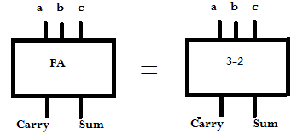
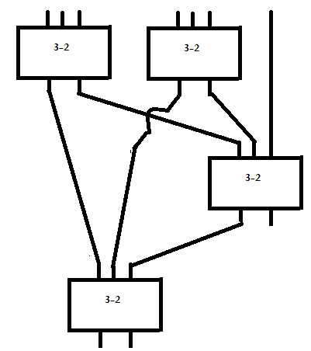
3-2 and 7-3 compressors
3-2 (FA):
7-3:

Slide 7
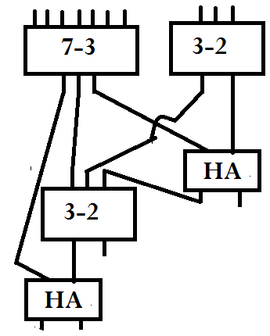
10-4 compressor
10-4 Compressor using 7-3, 3-2 and 2-2 compressors:

Slide 8
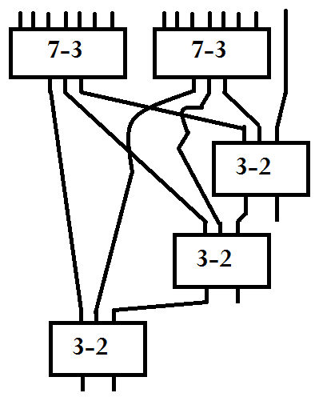
15-4 compressor
15-4 Compressor using
7-3 and 3-2 compressors:

Slide 9
Advanced compressors
Advanced compressors have 3 properties:
A compressor must have 2 properties:
1) Must do the addition operation
2) The number of inputs > The number of outputs
3) Carry in(s) must not change the Carry out (s)
This compressor must satisfy the two first conditions and also the third one.
Carry ins and carry outs are not considered as the bits to be compressed. In other words, Carry ins and Carry outs must generated and consumed in the circuit design.

Slide 10
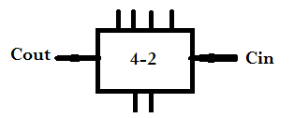
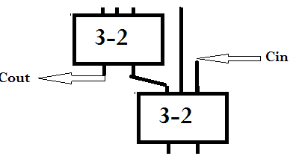
4-2 Compressor
The schema of 4-2 compressor follows:
4-2 compressor using 3-2 compressors:

Slide 11
Dot Matrix representation
A "dot matrix representation of multiplication" refers to visually depicting the process of matrix multiplication using a grid of dots, where each dot represents a value in the matrix, and the multiplication is performed by calculating the "dot product" between corresponding rows and columns, essentially summing the products of the elements at matching positions between the rows and columns involved in the calculation.

Slide 12
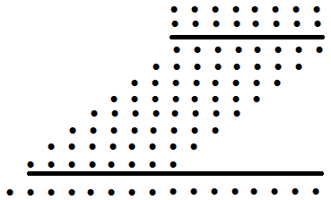
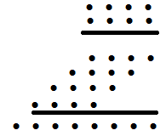
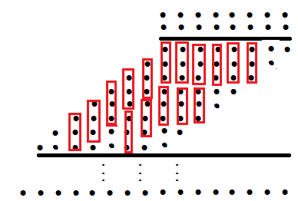
Dot Matrix in Multiplication
Dot Representation:
First step simplifying the Multiplication tree using 3-2s (FAs)

Slide 13
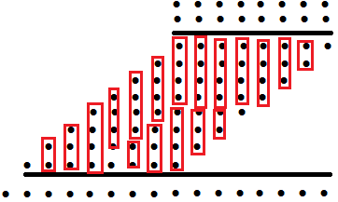
Dot Matrix Multiplication (continued)
First step simplifying the Multiplication tree using 4-2s, 3-2s (FAs) and HAs

Slide 14
Multi-Operand Addition
Multi-operand addition is a fundamental arithmetic problem that involves adding multiple numbers together. It's used in many applications, including computer graphics, robotics, and signal processing.
There are different approaches to perform multi-operand addition:
Use a two-operand adder sequentially
This method can be used to add multiple numbers together by using a single two-operand adder in sequence.
Use a tree of carry-save adders (3-2 compressors)
This method can be used to implement multi-operand addition of radix 2 signed-digit operands.
Use compressors.

Slide 15
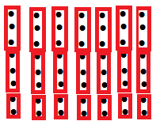
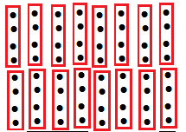
Multi-Operand Addition (continued)
First step simplifying the Multi-operand addition using 3-2s (FAs) and Has:
First step simplifying the Multi-operand addition using 4-2s

Slide 16
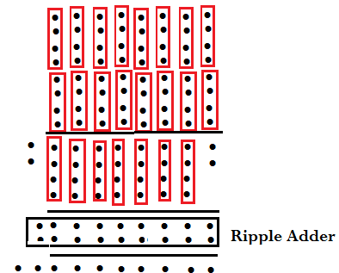
Multi-Operand Addition (continued)
The process of reduction must be continued until achieving the maximum of two bits in each column. As an example:
Simplifying the Multi-operand addition using 4-2s:

Slide 17
Binary Division
Binary Division, the same as decimal division:
Divide the suitable digits of the dividend and record the quotient.
Multiply the divisor by the quotient and write the product below.
Subtract the product from the dividend and write the difference below.
Bring down the next digit and repeat.

Slide 18
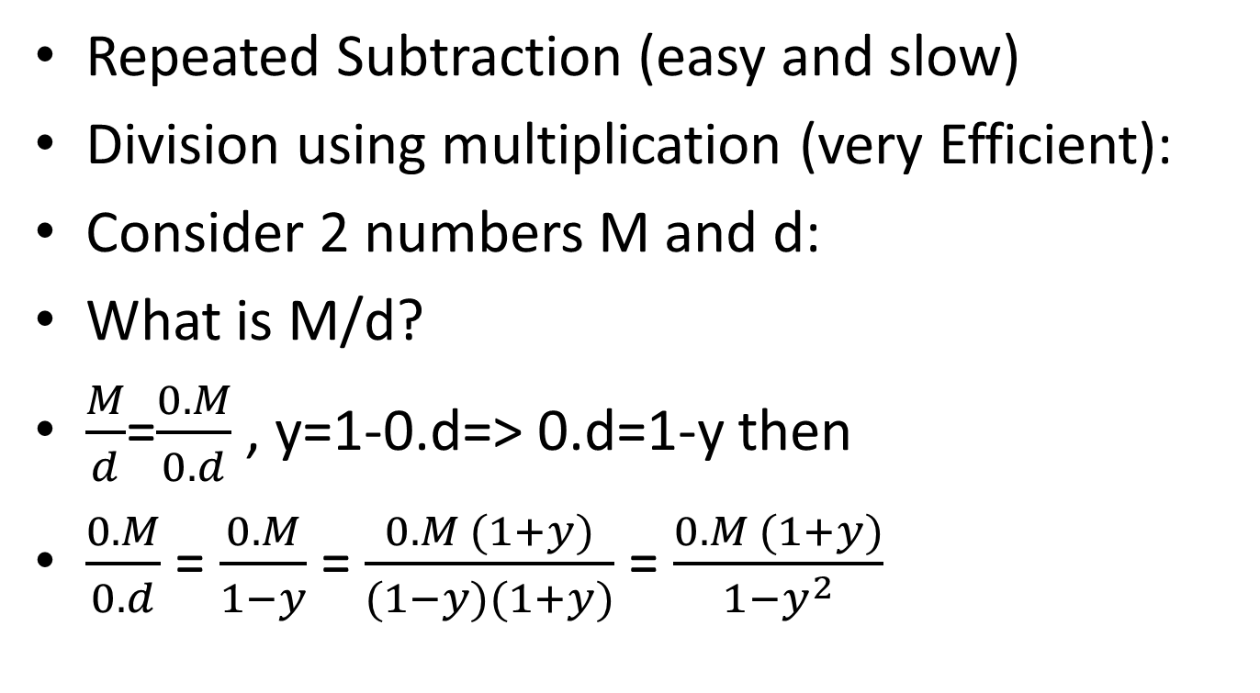
Alternative ways of division
Repeated Subtraction (easy and slow)
Division using multiplication (very Efficient):
Consider 2 numbers M and d:
What is M/d?
$\frac{M}{d}$=$\frac{0.M}{0.d}$ , y=1-0.d=> 0.d=1-y then
$\frac{0.M}{0.d}$ = $\frac{0.M}{1−y}$ = $\frac{0.M (1+y)}{(1−y)(1+y)}$ = $\frac{0.M (1+y)}{1−y^{2}}$

Slide 19
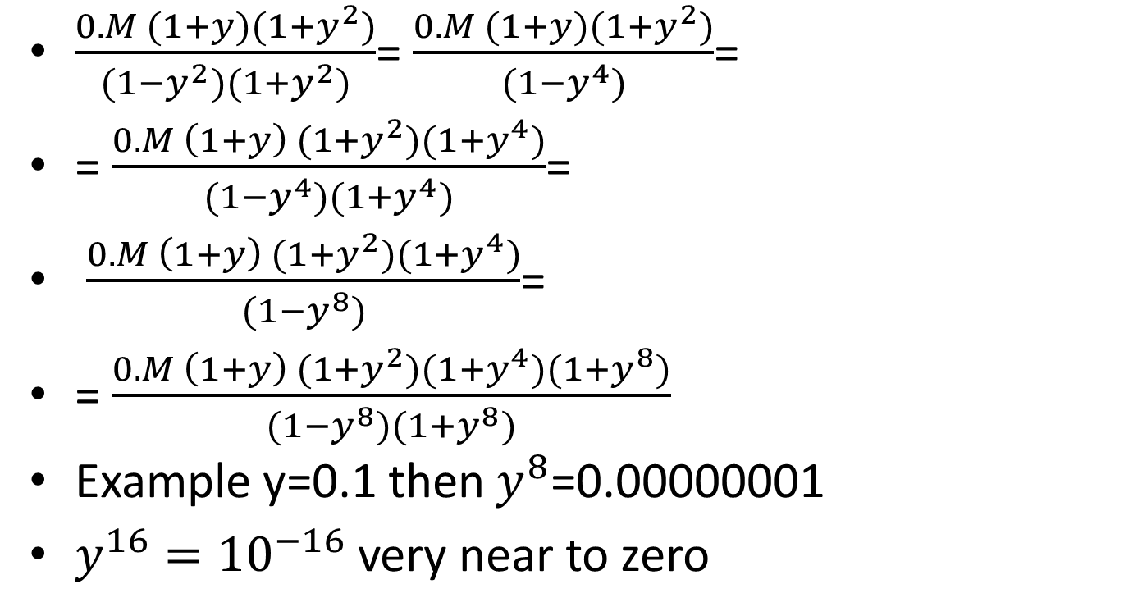
Alternative ways of division (continued)
$\frac{0.M (1+y)(1+y^{2})}{(1−y^{2})(1+y^{2})}$= $\frac{0.M (1+y)(1+y^{2})}{(1−y^{4})}$=
= $\frac{0.M \left(1+y\right) (1+y^{2})(1+y^{4})}{(1−y^{4})(1+y^{4})}$=
$\frac{0.M \left(1+y\right) (1+y^{2})(1+y^{4})}{(1−y^{8})}$=
= $\frac{0.M \left(1+y\right) (1+y^{2})(1+y^{4})(1+y^{8})}{(1−y^{8})(1+y^{8})}$
Example y=0.1 then $y^{8}$=0.00000001
$y^{16}={10}^{−16}$ very near to zero

